Slide 1

Quantifying Visual Abstraction Quality for Stipple Drawings
Marc Spicker
Visual Computing Group
University of Konstanz, Germany

Slide 2
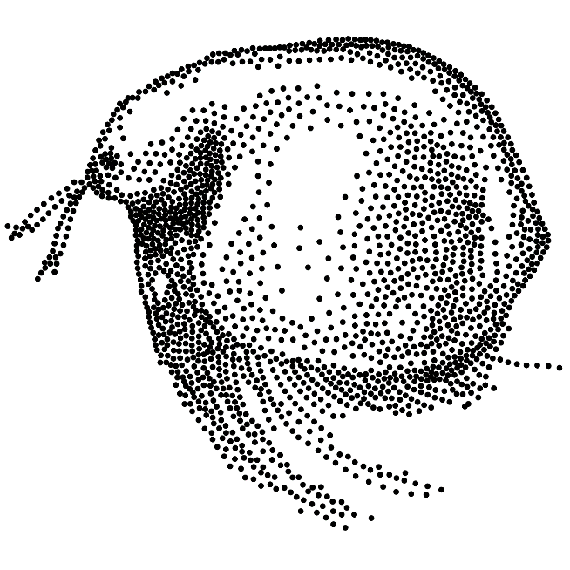
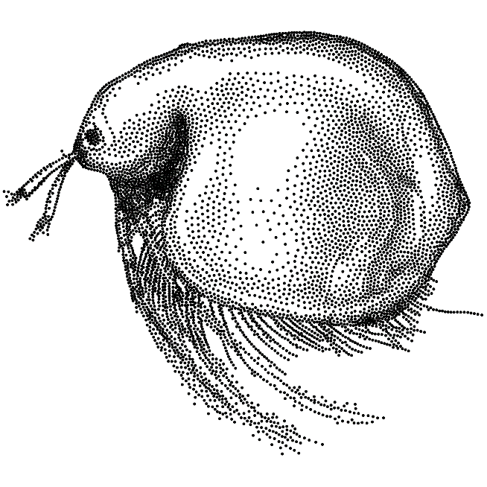

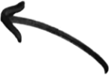
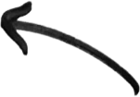
Motivation
Stippling: Illustration technique creating the appearance of shading by placing only dots.
Too few dots?
Too many dots?

Slide 3
Motivation
Choosing the number of dots always involves trade-offs:
Question we want to address:
What is a good trade-off for the viewer?
Fewer dots | More dots
Desired abstraction quality | Preservation of details
Specific Stippling look | Photorealistic impression
Low computation time | High computation time

Slide 4
Overview
Stippling Normalization
Stippling Algorithm
User Study
Evaluation / Statistical Model
Enables comparisons between different input images
New normalization: tonal percentage
Algorithmic choices
Short presentation of the algorithm
Study design
Pairwise comparison
Crowdsourcing
Quality control
From relative to absolute scoring
Confirmation study
Conclusion

Slide 5
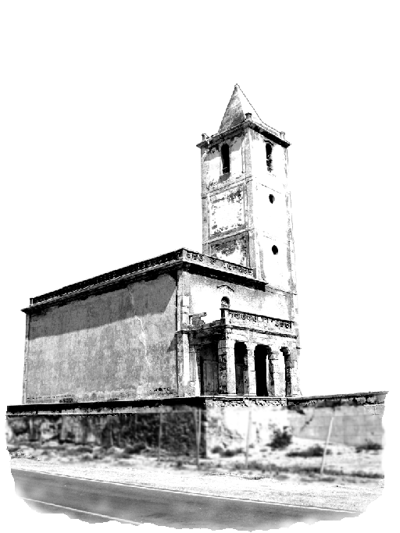
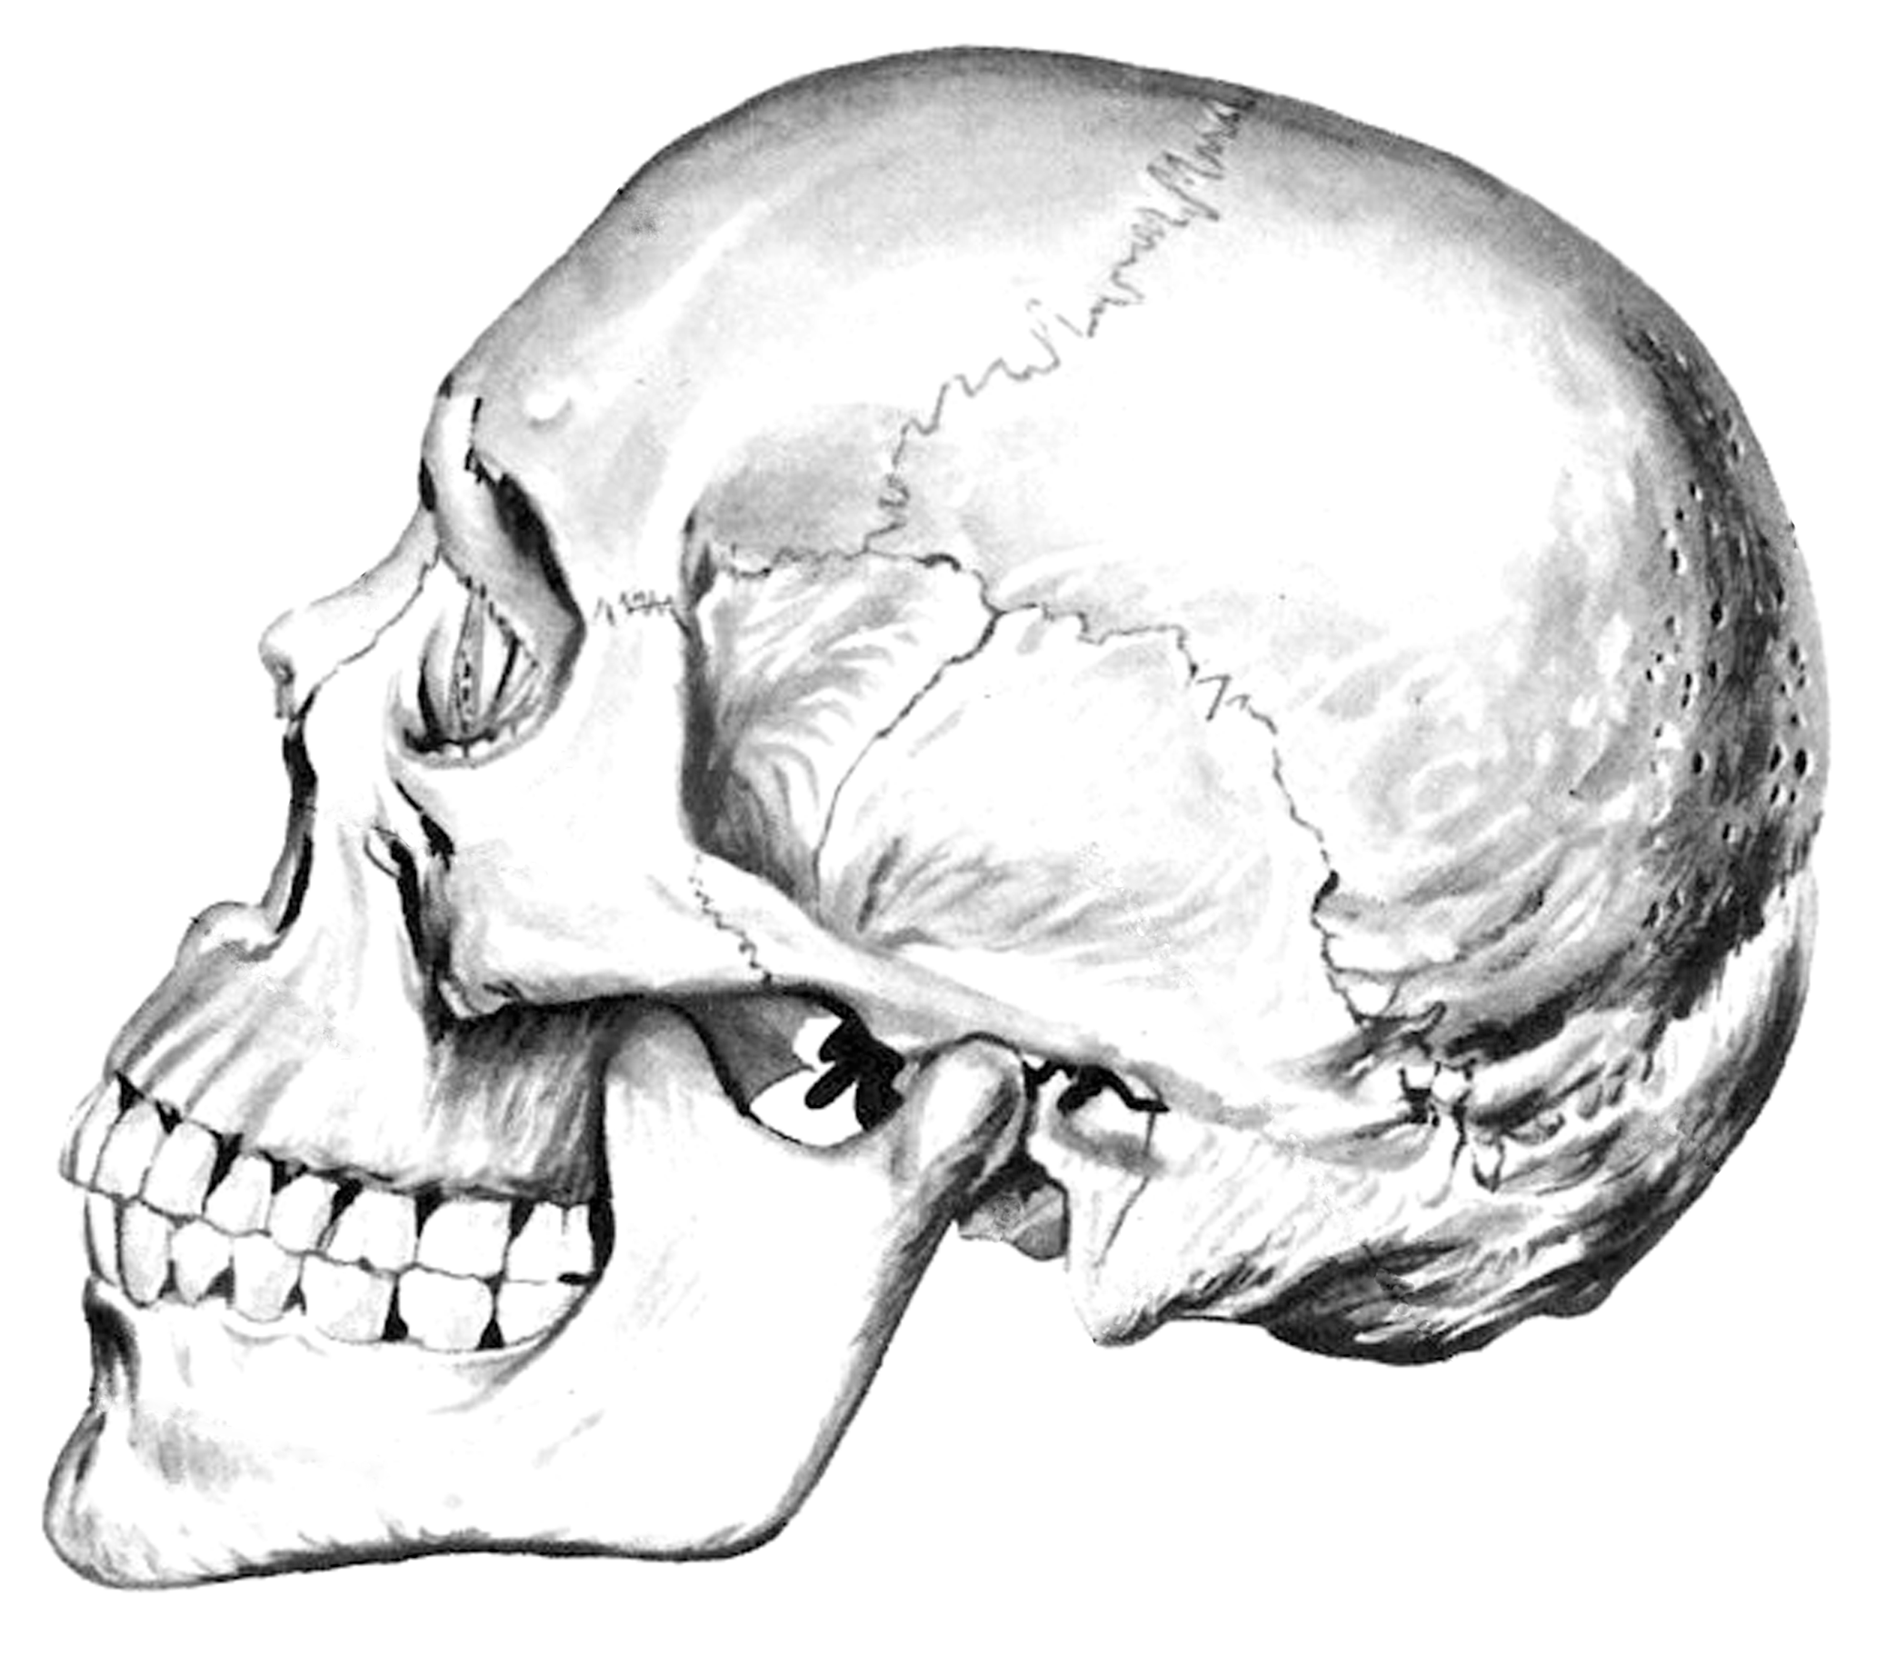
Stippling Normalization
Cannot directly compare number of stipples for representations of different inputs!
Larger/Darker images need more dots than smaller/ brighter ones.
Simply normalizing inputs requires changing them and can destroy artistic intent.

Slide 6

Stippling Normalization
Our solution: Normalize the number of points.
Integrate tonal values (black 1, white 0) over the input tonal sum
Use fraction of tonal sum as normalized number of points tonal percentage τ
Average tonal:
Tonal sum:
Tonal percentage:
1000px
200.000
10% ≙ 20.000 points
0.2
1000px

Slide 7



Stippling Normalization
5% ≙ ~1.800 points
15% ≙ ~5.500 points
25% ≙ ~9.200 points

Slide 8

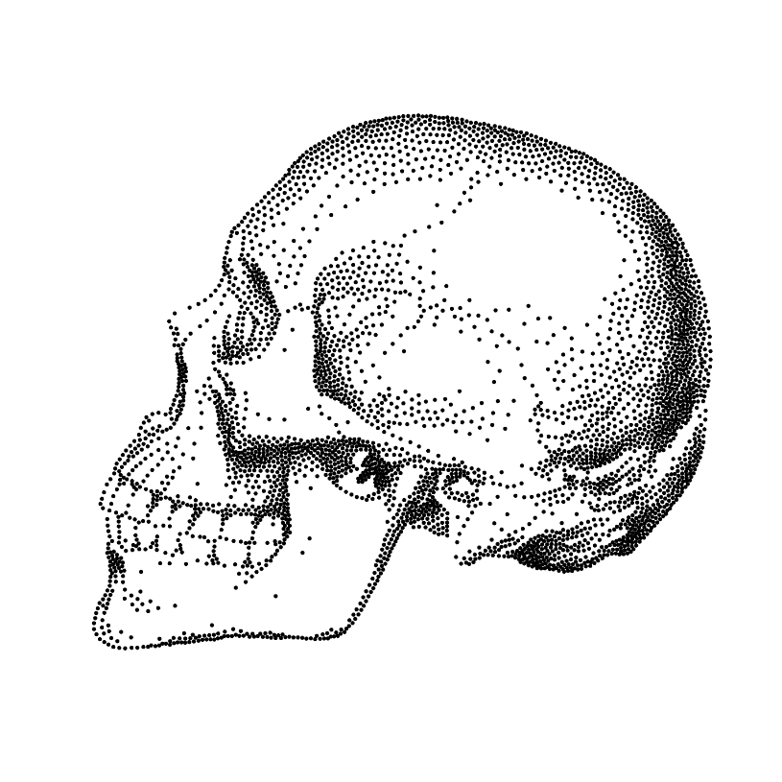
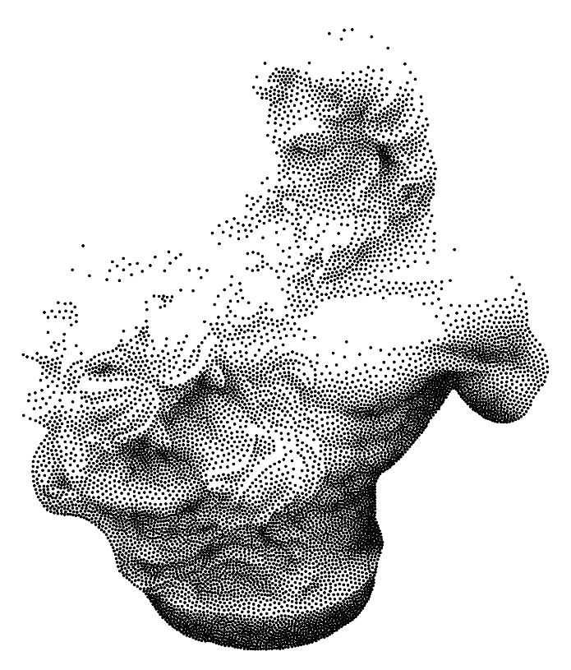
Stippling Normalization
30% ≙ ~4.000 points
30% ≙ ~9.000 points
30% ≙ ~11.200 points

Slide 9

Stippling Algorithm
Based on [Secord 2002] using weighted Lloyd relaxation.

Slide 10
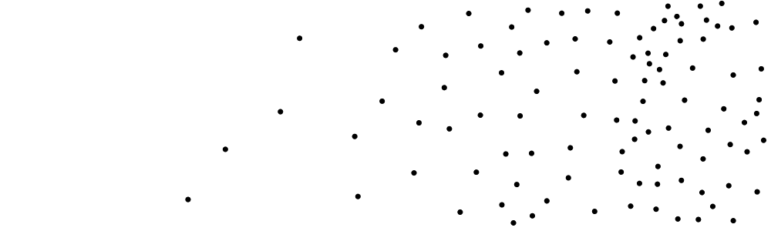
Stippling Algorithm
Based on [Secord 2002] using weighted Lloyd relaxation.
Initialize n points (rejection sampling).

Slide 11
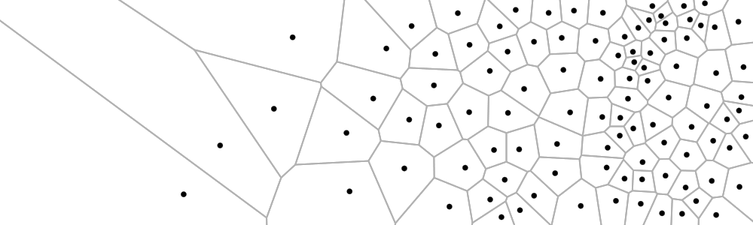
Stippling Algorithm
Based on [Secord 2002] using weighted Lloyd relaxation.
Calculate Voronoi diagram.

Slide 12

Stippling Algorithm
Based on [Secord 2002] using weighted Lloyd relaxation.
Repeat: Move points to weighted centroid of respective cells.

Slide 13
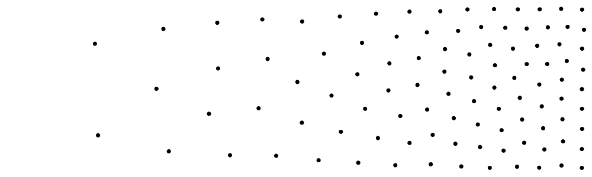
Stippling Algorithm
Based on [Secord 2002] using weighted Lloyd relaxation.
Offers direct control over the number of points and is widely used.

Slide 14
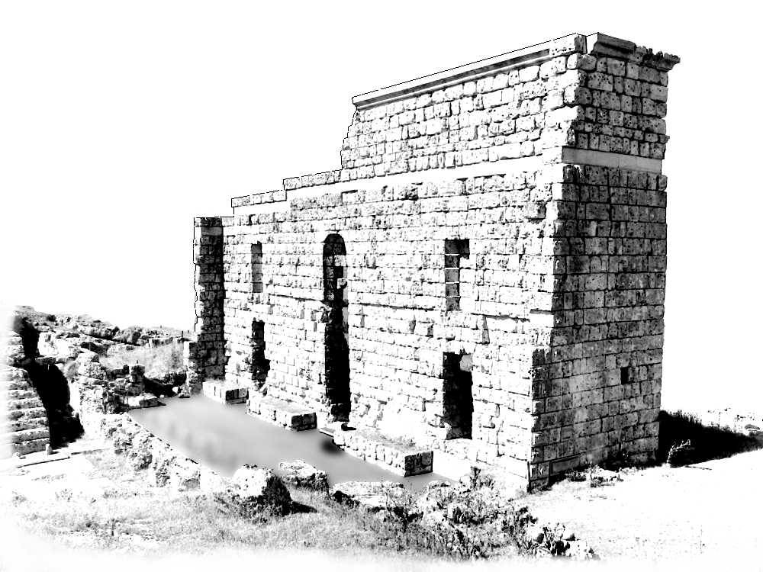
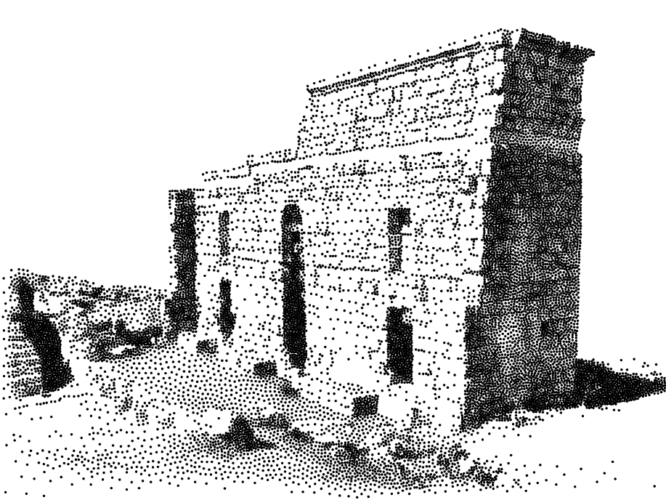
User Study
Assessing quality of an image abstraction is a difficult task.
Is this a good stippled representation?

Slide 15
User Study
The same ‘score’ might be interpreted differently from person to person. What does ‘good’ even mean? How can this be judged?
Minimum and maximum scores may be hard to judge. What is the best and worst possible abstract representation?
Instead show the user 2 different abstractions and ask which one is better!
A
B
Do you consider version A or B the better abstract representation?

Slide 16
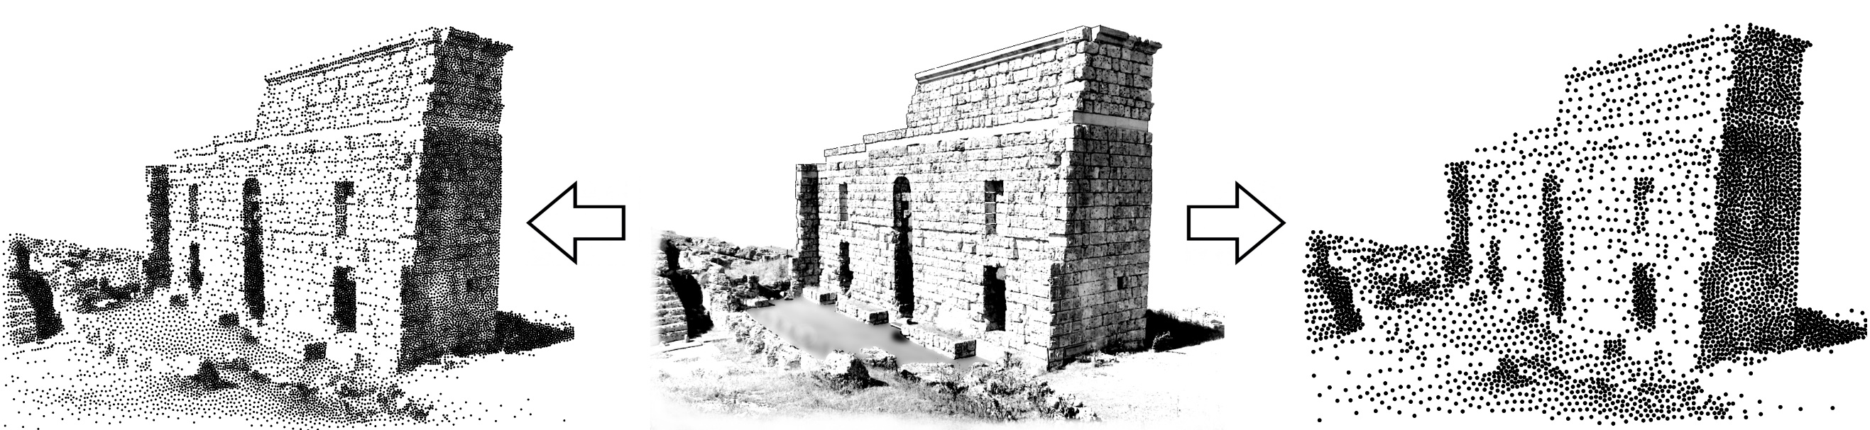
User Study
Which stippled representation (left or right) do you consider to better represent an image (center)?

Slide 17

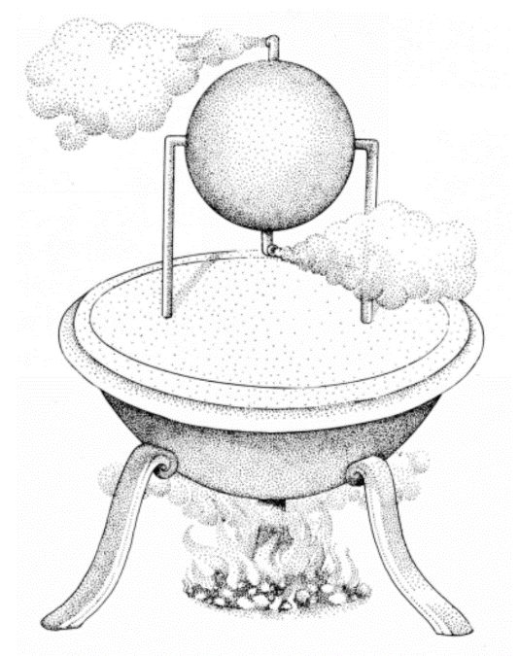
User Study
Conducted on crowdsourcing platform CrowdFlower¹.
Quality control:
Introduction to Stippling (definition, example).
Questionaire (test questions with known answers).
Feedback to the user after failing test questions.
¹www.crowdflower.com
Image taken from: The Atlas of Early Man, St. Martin‘s Press Inc., 1976

Slide 18
User Study: Test Questions
Questions with known answers used to filter out user input, 2 different types.
Identity:
From pilot study:

Slide 19
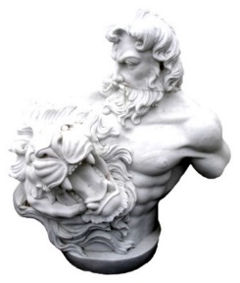

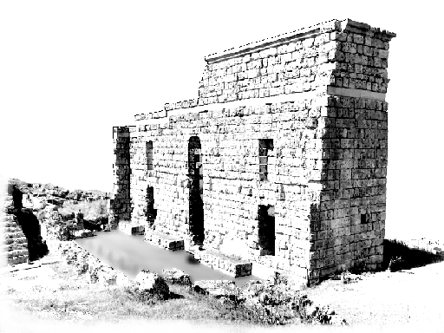
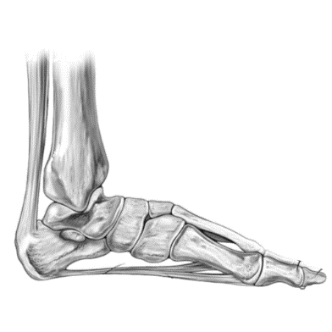

User Study
6 inputs images:
20 tonal percentages (distributed logarithmically).
Each pairwise comparison given to 50 different users.
Excluding symmetric questions but including identity:
6 stimuli x 210 comparisons x 50 users = 63000 valid answers

Slide 20

Evaluation: From Relative to Absolute Scores
Until now only relative data: votes for different comparisons.
Simple method: vote counting.
More advanced: Thurstone‘s Model.
Can be thought of as giving weight to the votes.
Our extension: Not just binary (left or right), but 5 point likert-scale.
Team | Score
1. Team A | 10
2. Team C | 7
3. Team B | 6
... | ...
Team A 3 – 2 Team B

Slide 21
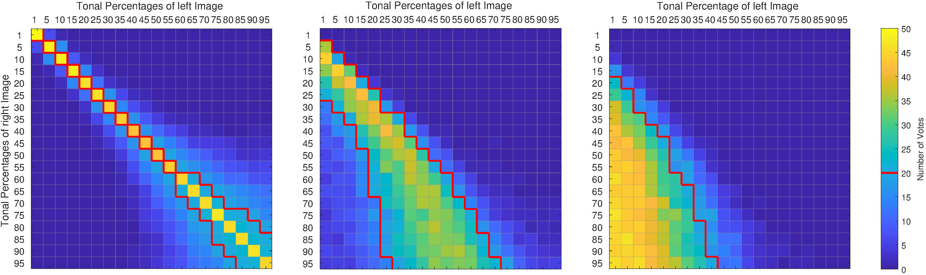
Evaluation: From Relative to Absolute Scores
Result of paired comparisons: count matrix (in our case 3):
Calculate probabilities of user preferences empirically and perform Maximum Likelihood Estimation to determine scale values.
„no difference“
„slightly better“
„much better“

Slide 22
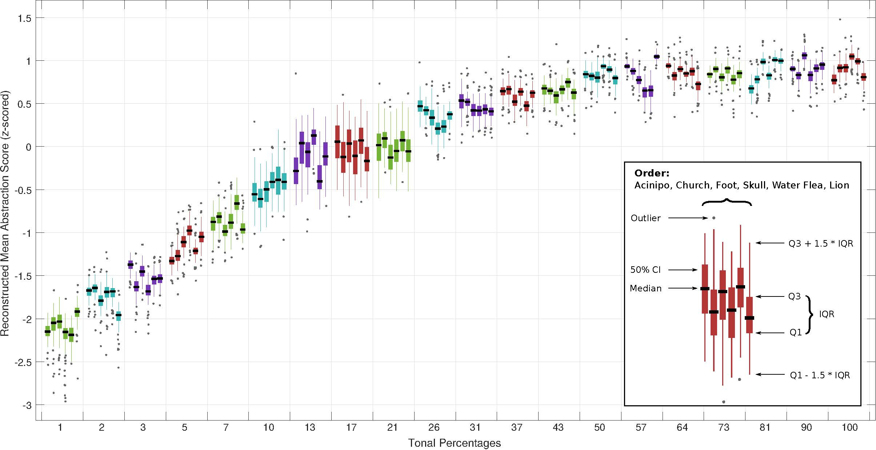
Evaluation: Absolute Abstraction Scores

Slide 23
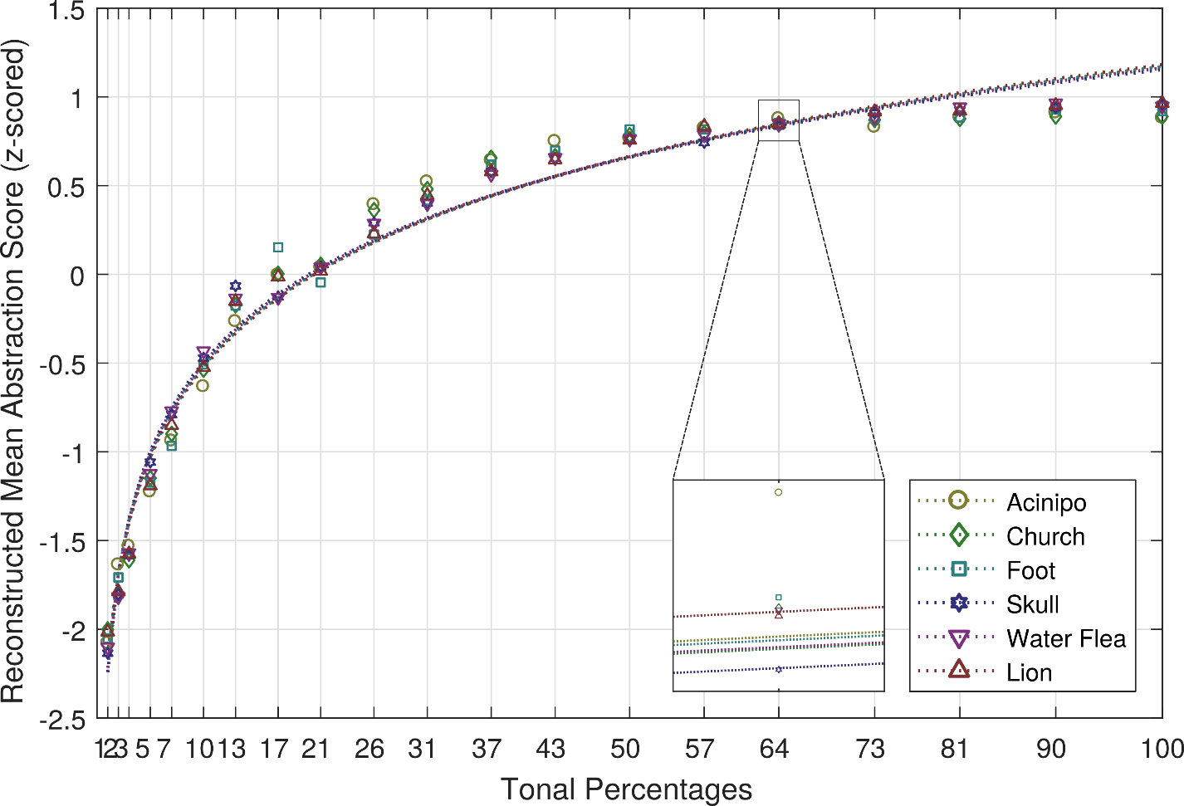
Evaluation: Reconstructed Model

Slide 24
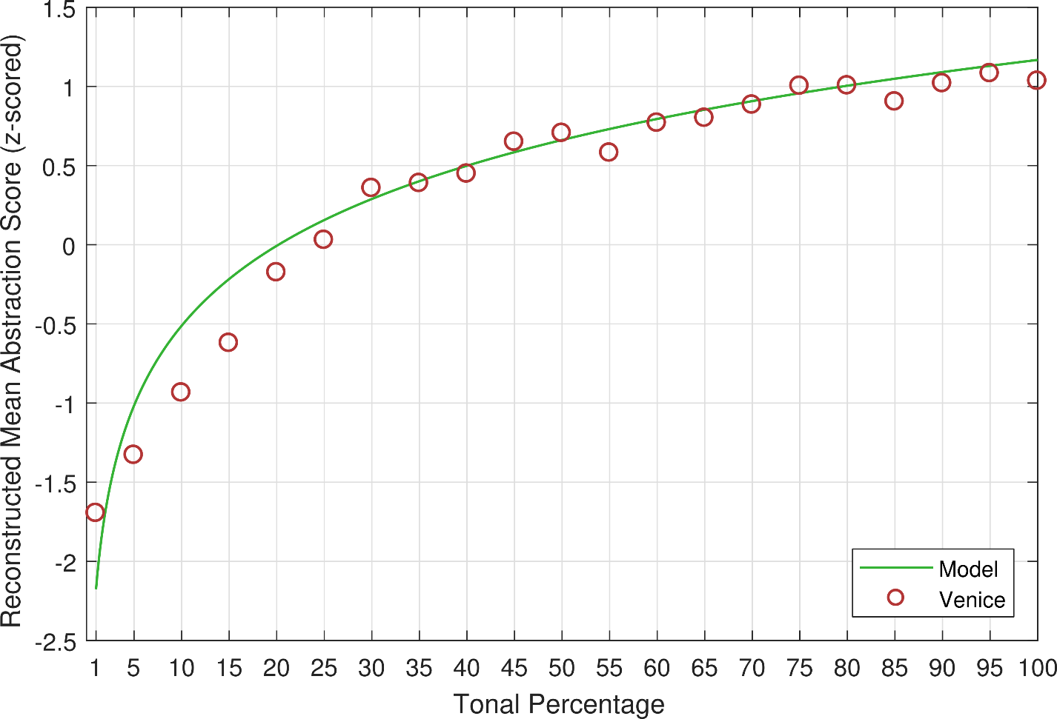
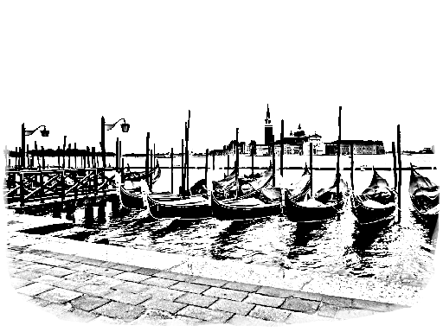
Evaluation: Confirmation

Slide 25
Conclusion
Presented new way of comparing / normalizing stipple drawings from different inputs: tonal percentage.
Using this measure, we showed a logarithmic dependency between number of points and perceived abstraction quality independent of the input image.
Showed that Weber-Fechner‘s law also holds for abstract representations (at least for stipple drawings until now).

Slide 26
Conclusion: Practical Remarks
This is nice. But how do I use the proposed model in practice?
Abstraction quality is steadily increasing no optimal value!
Desired quality always depends on application.
Beware of image semantics!
From function gradient: Decide if increase in number of points is worth corresponding change in quality:
Increasing tonal percentage from 10% to 20% increases perceived quality more than three times as much as from 40% to 50%
Our suggestion: Aim for 20% - 40% to achieve a good trade-off

Slide 27
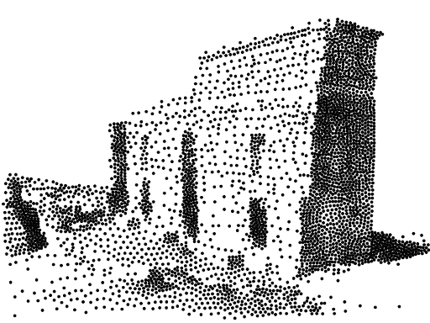

Conclusion: Practical Remarks
10% ≙ ~3.700 points
20% ≙ ~7.500 points

Slide 28
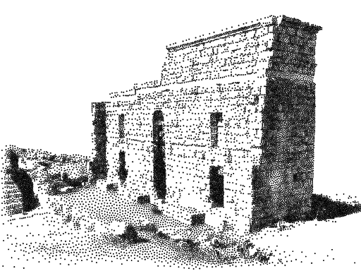
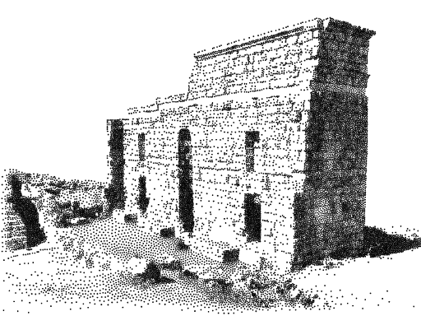
Conclusion: Practical Remarks
40% ≙ ~15.000 points
50% ≙ ~18.700 points

Slide 29
Future Work
Extend Stippling studies:
Importance maps (edges, saliency, …)
Different Stippling algorithms
Variable Stipple sizes
Different rendering primitives
Lines
Strokes
…

Slide 30
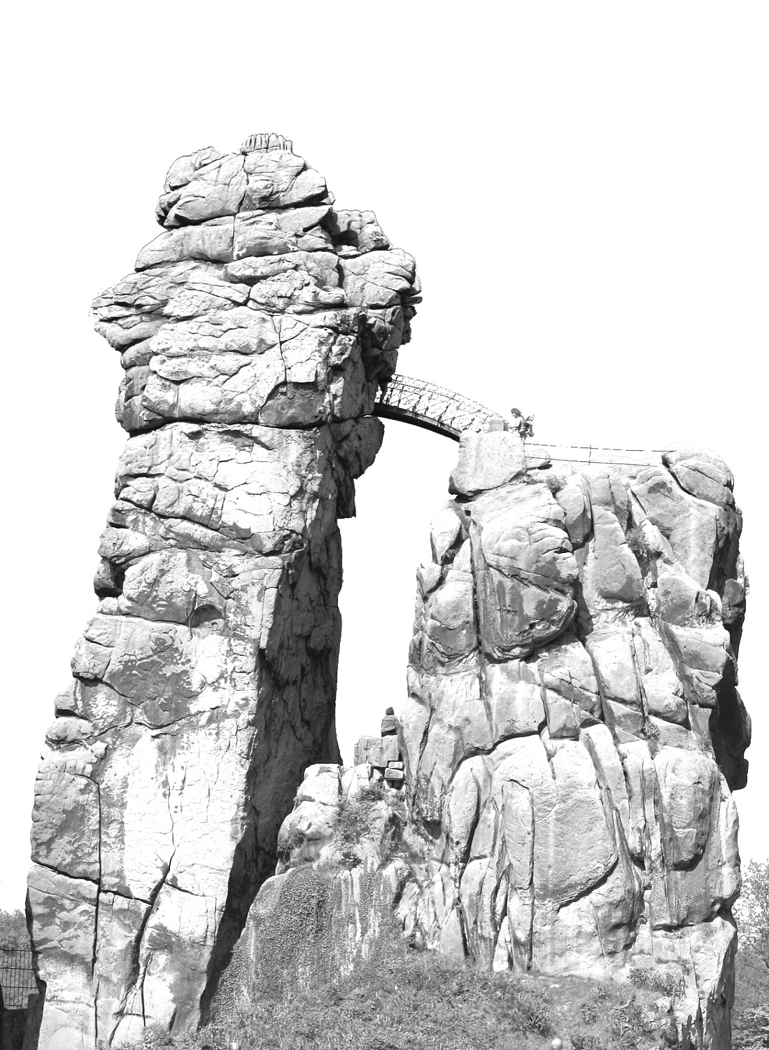
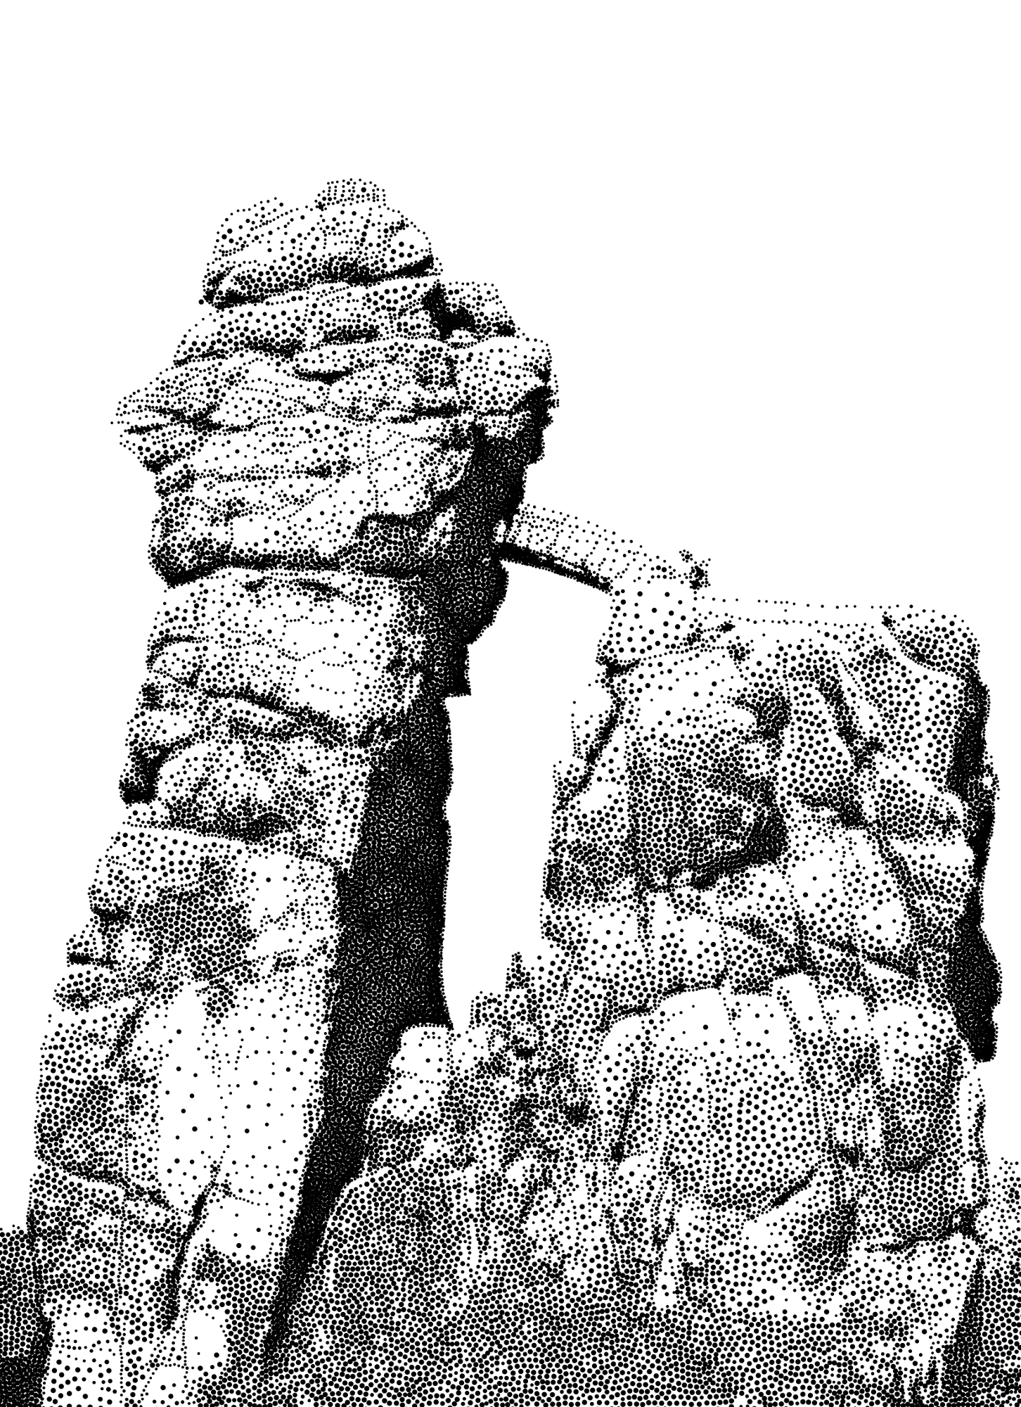

Slide 31




Project Website
goo.gl/dKLz7B
Available materials:
User study data
Image data
Paper
Presentation

Slide 32
Thank You!

Slide 33
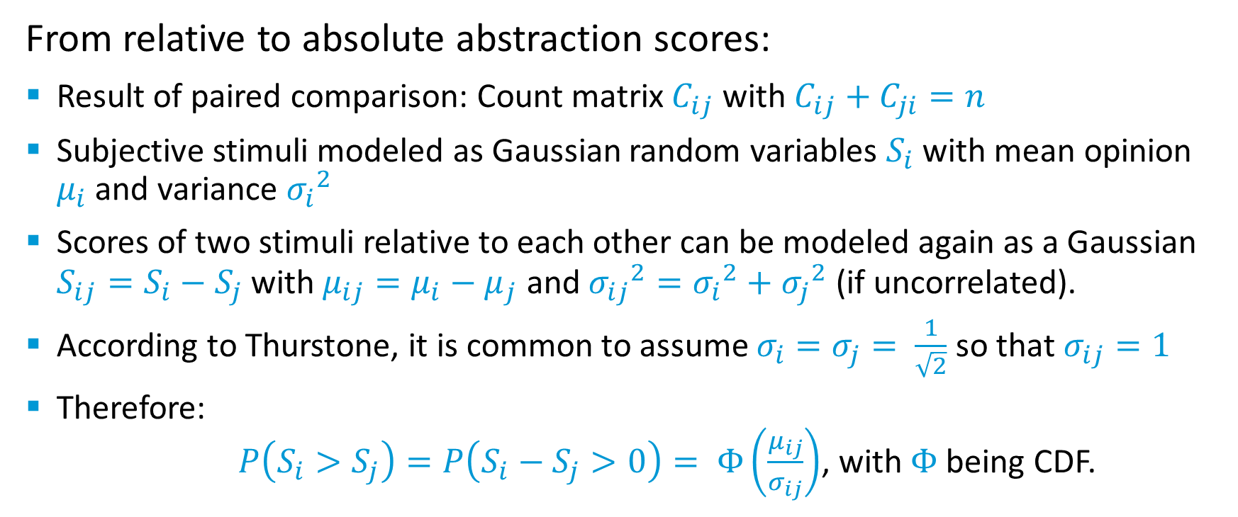
Evaluation: Thurstones Model
From relative to absolute abstraction scores:
Result of paired comparison: Count matrix $C_{ij}$ with $C_{ij}+C_{ji}=n$
Subjective stimuli modeled as Gaussian random variables $S_{i}$ with mean opinion $μ_{i}$ and variance ${σ_{i}}^{2}$
Scores of two stimuli relative to each other can be modeled again as a Gaussian $S_{ij}=S_{i}−S_{j}$ with $μ_{ij}=μ_{i}−μ_{j}$ and ${σ_{ij}}^{2}={σ_{i}}^{2}+{σ_{j}}^{2}$ (if uncorrelated).
According to Thurstone, it is common to assume $σ_{i}=σ_{j}= \frac{1}{\sqrt{2}}$ so that $σ_{ij}=1$
Therefore: $P\left(S_{i}>S_{j}\right)=P\left(S_{i}−S_{j}>0\right)= Φ\left(\frac{μ_{ij}}{σ_{ij}}\right)$, with $Φ$ being CDF.

Slide 34
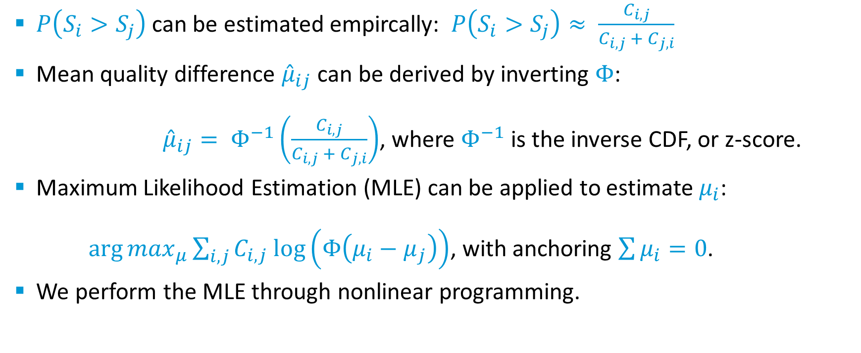
Evaluation: Thurstones Model
$P\left(S_{i}>S_{j}\right)$ can be estimated empircally: $P\left(S_{i}>S_{j}\right)≈ \frac{C_{i,j}}{C_{i,j} + C_{j,i}}$
Mean quality difference ${\hat{μ}}_{ij}$ can be derived by inverting $Φ$: ${\hat{μ}}_{ij}= Φ^{−1}\left(\frac{C_{i,j}}{C_{i,j} + C_{j,i}}\right)$, where $Φ^{−1}$ is the inverse CDF, or z-score.
Maximum Likelihood Estimation (MLE) can be applied to estimate $μ_{i}$: ${\arg{max}}_{μ}\sum_{i,j}{C_{i,j} log⁡\left(Φ\left(μ_{i}−μ_{j}\right)\right)}$, with anchoring $\sum{μ_{i}=0}$.
We perform the MLE through nonlinear programming.

Slide 35
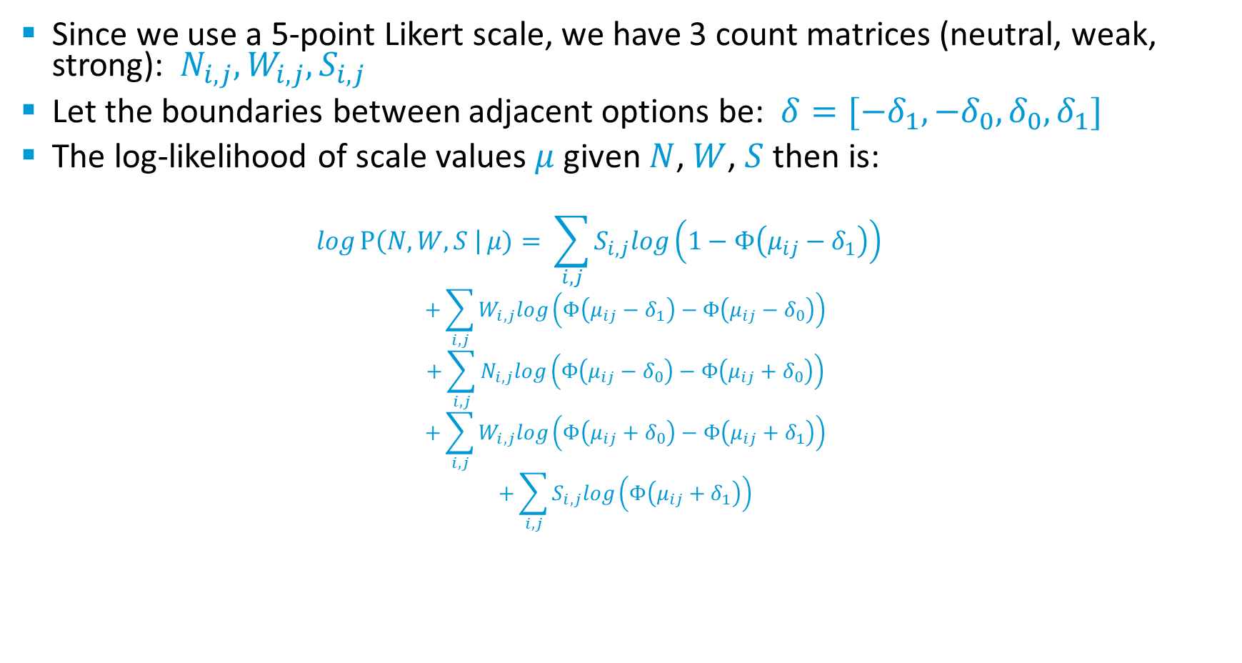
Evaluation: Thurstones Model
Since we use a 5-point Likert scale, we have 3 count matrices (neutral, weak, strong): $N_{i,j}, W_{i,j},S_{i,j}$
Let the boundaries between adjacent options be: $δ=[{−δ}_{1},{−δ}_{0},δ_{0},δ_{1}]$
The log-likelihood of scale values $μ$ given $N$, $W$, $S$ then is:
$$logP\left(N,W,S \right|μ)= \sum_{i,j}{S_{i,j}log\left(1−Φ\left(μ_{ij}−δ_{1}\right)\right)}$$
$$+\sum_{i,j}{W_{i,j}log\left(Φ\left(μ_{ij}−δ_{1}\right)−Φ\left(μ_{ij}−δ_{0}\right)\right)}$$
$$+\sum_{i,j}{N_{i,j}log\left(Φ\left(μ_{ij}−δ_{0}\right)−Φ\left(μ_{ij}+δ_{0}\right)\right)}$$
$$+\sum_{i,j}{W_{i,j}log\left(Φ\left(μ_{ij}+δ_{0}\right)−Φ\left(μ_{ij}+δ_{1}\right)\right)}$$
$$+\sum_{i,j}{S_{i,j}log\left(Φ\left(μ_{ij}+δ_{1}\right)\right)}$$

